Slide 1
E is for
Evidence-Based
Intro and Tips for the TEACH Principles

Slide 2
What are the TEACH Principles?
Developed by the Senate Teaching and Learning Committee
Academic Senate endorsed spring 2022
"Principles of Good Practice in Teaching"
Based in:
  Need for a better "definition" of good teaching
  Literature around best practices

Slide 3


TEACH
TRANSPARENT│EVIDENCE-BASED │ ASPIRATIONAL │ COMMUNICATIVE │ HUMANE
ysu.edu/TEACH

Slide 4
Evidence-Based Teaching
EBTs are strategies that have been proven to:
Deepen learning
Increase retention
Promote equity
There are a lot of evidence-based practices, so you can find options that fit your teaching style and discipline.
They can take the guesswork out of which strategies to use!

Slide 5
Evidence-Based Teaching
A few easy-to-incorporate examples:
Active Learning: Freeman et al. (2014) found that just 10-15% of class time devoted to active learning has significant impacts. In a MWF course, that means as little as 5 minutes of discussion time can
Classroom Assessment Techniques: These short, formative assessment activities let you gauge student learning along the way (and before they need to demonstrate!)
Advanced Organizers: Advanced organizers are themes, questions, and considerations for students to engage more in homework or course readings. Can be submitted for points, used as study guides, etc. (similar to guided notes and active reading documents)
Notes:
Active Learning: https://ysu.edu/institute-teaching-and-learning/active-learning
CATs: https://www.celt.iastate.edu/instructional-strategies/evaluating-teaching/classroom-assessment-techniques-quick-strategies-to-check-student-learning-in-class/
Advanced Organizers (last of accordion menu): https://ysu.edu/institute-teaching-and-learning/teacher-designs-instruction-help-students-see-connections-prior

Slide 6
Evidence-Based Teaching Characteristics
Uses a variety of student-centered strategies
Designs instruction to help students see connections to prior understanding
Helps students apply metacognition to their learning
Notes:
TEACH site: https://ysu.edu/institute-teaching-and-learning/principles-good-practice-teaching

Slide 7
Evidence-Based Tip: Concept Maps
Evidence-based strategy: scaffold knowledge or connect prior knowledge to new information
  If a person knew how to make a lemon meringue pie, it would be easy for them to learn how to make a baked Alaska
A big difference between novices (your students) and experts (you, as instructors) is the ability to make connections between disciplinary concepts—experts’ knowledge is well-organized
Concept maps visually organize knowledge and show relationships between ideas
Can be paper-based or use technology—tools here
Citations: TEACH site, Concept Maps, expert knowledge, mapping tools
Notes:
Drawn from:
TEACH Website: https://ysu.edu/institute-teaching-and-learning/principles-good-practice-teaching
BYU Article on Concept Mapping: https://teachanywhere.byu.edu/concept-mapping
Differences between experts and novices: https://www.linkedin.com/pulse/how-experts-differ-from-novices-andreea-tau/
Tools for concept mapping: https://ysu.edu/institute-teaching-and-learning/teacher-designs-instruction-help-students-see-connections-prior

Slide 8
Today’s Goals
Concept Map Example
Familiarize yourself with concept mapping as a study strategy.
Connect key time management concepts.
Notes:
This is a simple example that can be useful to introduce the concept to your students—feel free to use these slides if useful in your course! We have used in several other courses with more advanced concepts, not just in an intro class

Slide 9
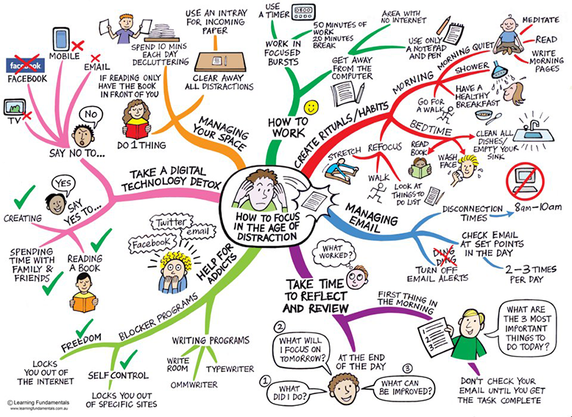

Slide 10
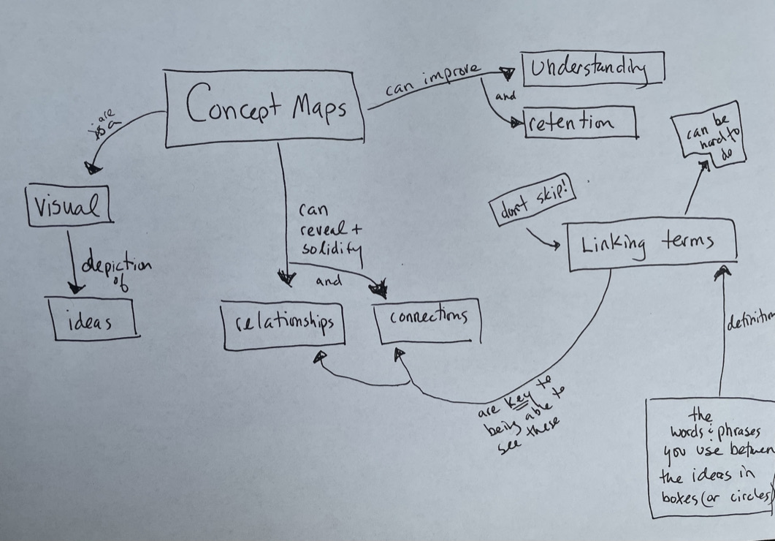

Slide 11
Terms I’m going to give you
Connections with arrows
“Linking terms” – help connect ideas

Slide 12
Social Media
Workspace
Phone
Schedule
Habits
Breaks
Timer
Reflection
Organization
Daily Goals
Weekly Goals
Semester Goals
College Goals
Tasks
Prioritization
Obstacles
Free Time
Flexibility
Procrastination
Sleep
Notes:
After providing these terms, the students came up with the examples on the wall. None were the same, but it showed that they were thinking deeply about how these terms/concepts related to each other.

Slide 13


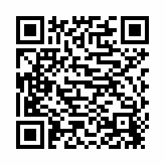

DID YOU SIGN-IN?
Engage with ITL 3 times this fall through workshops, book club, podcast groups, or consults and receive a $25 gift card.
THANK YOU
for joining us today! Before you go…
Complete a feedback card or fill out a feedback form online.

