Slide 1


Office of Human Resources
330.941.1508
hr@ysu.edu
Megan Massaro
mlmassaro@ysu.edu
330.941.3148
Performance Evaluations

Slide 2
Performance Management Cycle
Step 1
Set Performance Goals for Department
Step 3
Provide Support & Feedback
Step 4
Evaluate Performance
Step 2
Develop Employee Objectives & Goals
Notes:
The purpose of the Performance Management System is to assist in building a better organization through proper planning, goal setting, and fostering communication between Supervisors and Employees to improve work performance, assist with employee career development, identify areas for improvement, and achieve the overall strategic goals of Youngstown State University.
Performance Management should happen all year long and not a one time event.
Step 1
Set Performance Goals for Department
Step 2
Develop Employee Objectives & Goals
Step 3
Provide Support & Feedback
Step 4
Evaluate Performance

Slide 3
NEOED Performance Management
Create a Performance Plan
Check-in
Evaluate
Acknowledge
Acknowledge
Provides timely reminders and direct access
Creates a paperless flow that streamlines our process
Notes:
Provides timely reminders, online job descriptions and direct access
Creates a paperless flow that streamlines our process

Slide 4
SCHEDULE
Supervisor Creates Evaluation/Goals (due early in the year)
Supervisors review the content (and goals, if applicable) with employee(s) for the upcoming year
Employees receive an email to acknowledge the content/goals they will be evaluated on (due early in the year)
Supervisor Check-in (due mid-year)
Supervisors have a discussion with employee(s) regarding their performance to date and indicate in the system that they have completed the Mid Year Check-In.
Supervisor Evaluation (due by end of January each year)
Supervisors receive an email reminding them to evaluate their employee’s performance for the period ending on December 31st for the previous year
Employees receive an email notifying them that they have an evaluation to acknowledge/dispute.
Notes:
Supervisor Creates a Performance Plan (due by January 31st each year)
Supervisors will work with employees to develop a plan (characteristics & goals) for the upcoming year
Employees will receive an email indicating they have a Performance Plan to acknowledge (due about 1 week after the January 31st deadline)
Supervisor Check-in (due by July 1st each year)
Supervisors will have a discussion with employee(s) regarding their performance to date and will indicated in the system that they have completed the Progress Check-In.
Supervisor Evaluation (due by February 28th each year)
Supervisors will receive an email reminding them to evaluate their employee’s performance for the period ending on December 31st for the previous year
Employees will receive an email notifying them that they have an evaluation to acknowledge/dispute. (due about 1 week after the February 28th deadline)

Slide 5
CONTENT & GOALS
Content is not editable by the supervisor and may follow criteria based on collective bargaining agreements.
Supervisors may create goals for their employees that are within the scope of the position description and SMART (Specific, Measurable, Achievable, Relevant and Time-bound). Helpful Adjectives and Verbs handout is available to assist you in writing a goal.
Notes:
These characteristics are not editable by the supervisor and are the same for all Classified staff members across campus.
Supervisors may create goals for their employees that are within the scope of the job description and SMART (Specific, Measurable, Achievable, Relevant and Time-bound). Helpful Adjectives and Verbs handout is available to assist you in writing a goal.

Slide 6
SMART GOALS
S
Specific: State exactly what you want to accomplish (Who, What, When, Where, Why)
M
Measurable: How will you demonstrate and evaluate the extent to which the goal has been met.
A
Achievable: Stretch challenging goals within ability to achieve outcome. What is the action-oriented verb?
R
T
Relevant: How does the goal tie into your key responsibilities? How does it align to the department objectives?
Time-bound: Set 1 or more target dates, to explain "by when" this goal should be achieved (include deadlines, dates, and/or frequency)
Notes:
Specific: State exactly what you want to accomplish (Who, What, Where, Why, When)
Measurable: How will you demonstrate and evaluate the extent to which the goal has been met.
Achievable: Stretch and challenging goals within ability to achieve outcome. What is the action-oriented verb?
Relevant: How does the goal tie into your key responsibilities? How does it align to the department objectives?
Time-bound: Set 1 or more target dates, to explain "by when" this goal should be acheived (include deadlines, dates, and/or frequency)

Slide 7
MID YEAR CHECK-IN
Supervisors meet with employees midway through the evaluation period to discuss progress.
Supervisors acknowledge the check-in the system.
Employees have no action at this step.
Notes:
Meet with employees midway through the period to discuss progress.
Supervisors acknowledge the check-in the system.
Employees have no action at this step.

Slide 8
SELF EVALUATION (optional)
Employees have the opportunity to submit a self evaluation.
Enter self feedback and ratings in the system.
Can be used as a connection point for initiating conversation.
Notes:
Meet with your employees to discuss the evaluation period.
Plan to discuss your ratings and feedback at this meeting.
Enter your feedback and ratings in the system.
Employee will receive a notice to acknowledge the evaluation.

Slide 9
EVALUATE
Supervisors meet with employees to discuss the evaluation period.
Plan to discuss ratings and feedback at this meeting.
Enter feedback and ratings in the system.
Employee will receive a notice to sign the evaluation.
Notes:
Meet with your employees to discuss the evaluation period.
Plan to discuss your ratings and feedback at this meeting.
Enter your feedback and ratings in the system.
Employee will receive a notice to acknowledge the evaluation.

Slide 10
PERFORMANCE RATINGS
Level | Description of Performance Ratings
Outstanding/ Excellent | Has exceeded all of the performance expectations for this characteristic or goal. Performance is consistently & significantly beyond established standards. Achieves performance objectives at a fully outstanding level and demonstrates exceptional skill levels. Performance exceeds expectations by an exceptional degree.
Exceeds Requirements/ Frequently Exceeds/ Very Good/ Good | Regularly works beyond majority a of the performance expectations for this characteristic or goal. Performance is above satisfactory and expected level of performance. Contributions and work activities consistently exceed job requirements. Accomplishments toward goals and demonstrated personal skills generally surpass job requirements. Frequently performs work in an excellent manner and exceeds expected results.
Satisfactory/ Meets Requirements/ Average/ Adequate | Has met the performance standards for this characteristic or goal. Job requirements are performed in a full and complete manner. Consistently performs work in a satisfactory and acceptable manner and achieves expected results. Performance consistently meets job requirements. Achieves performance objectives stated.
Needs Improvement | Has failed to meet one or more of the significant performance expectations for this characteristic or goal. Some improvement needed to fully achieve the expected level of performance. Work activities do not consistently meet requirements due to specific weaknesses observed in one or more areas. Employee’s work does not consistently meet expectations. Employee must improve performance to achieve expected results. Performance is less than expected and needs improvement. Direction, supervision and learning are required if performance objectives are to be achieved.
Unsatisfactory/ Below Minimum/ Poor | Has failed to meet most or all of the significant performance expectations for this characteristic or goal. Employee displays poor work performance; immediate remedial action is needed. Performance is substantially weak. Performance objectives are not met. Substantial improvement by the employee is required.
N/A | Employee is not rated on this characteristic or goal. This characteristic or goal does not apply.
Notes:
Outstanding
Has exceeded all of the performance expectations for this characteristic or goal.
Performance is consistently & significantly beyond established standards. Achieves performance objectives at a fully outstanding level and demonstrates exceptional skill levels.
Performance exceeds expectations by an exceptional degree.
Exceeds
Requirements
Regularly works beyond majority a of the performance expectations for this characteristic or goal.
Performance is above satisfactory and expected level of performance.
Contributions and work activities consistently exceed job requirements. Accomplishments toward goals and demonstrated personal skills generally surpass job requirements.
Frequently performs work in an excellent manner and exceeds expected results.
Satisfactory
Has met the performance standards for this characteristic or goal.
Job requirements are performed in a full and complete manner
Consistently performs work in a satisfactory and acceptable manner and achieves expected results.
Performance consistently meets job requirements. Achieves performance objectives stated.
Needs
Improvement
Has failed to meet one or more of the significant performance expectations for this characteristic or goal.
Some improvement needed to fully achieve the expected level of performance.
Work activities do not consistently meet requirements due to specific weaknesses observed in one or more areas.
Employee’s work does not consistently meet expectations. Employee must improve performance to achieve expected results.
Performance is less than expected and needs improvement. Direction, supervision and learning are required if performance objectives are to be achieved.
Unsatisfactory
Has failed to meet most or all of the significant performance expectations for this characteristic or goal.
Employee displays poor work performance; immediate remedial action is needed.
Performance is substantially weak. Performance objectives are not met. Substantial improvement by the employee is required.
N/A
Employee is not rated on this characteristic or goal.
This characteristic or goal does not apply.

Slide 11
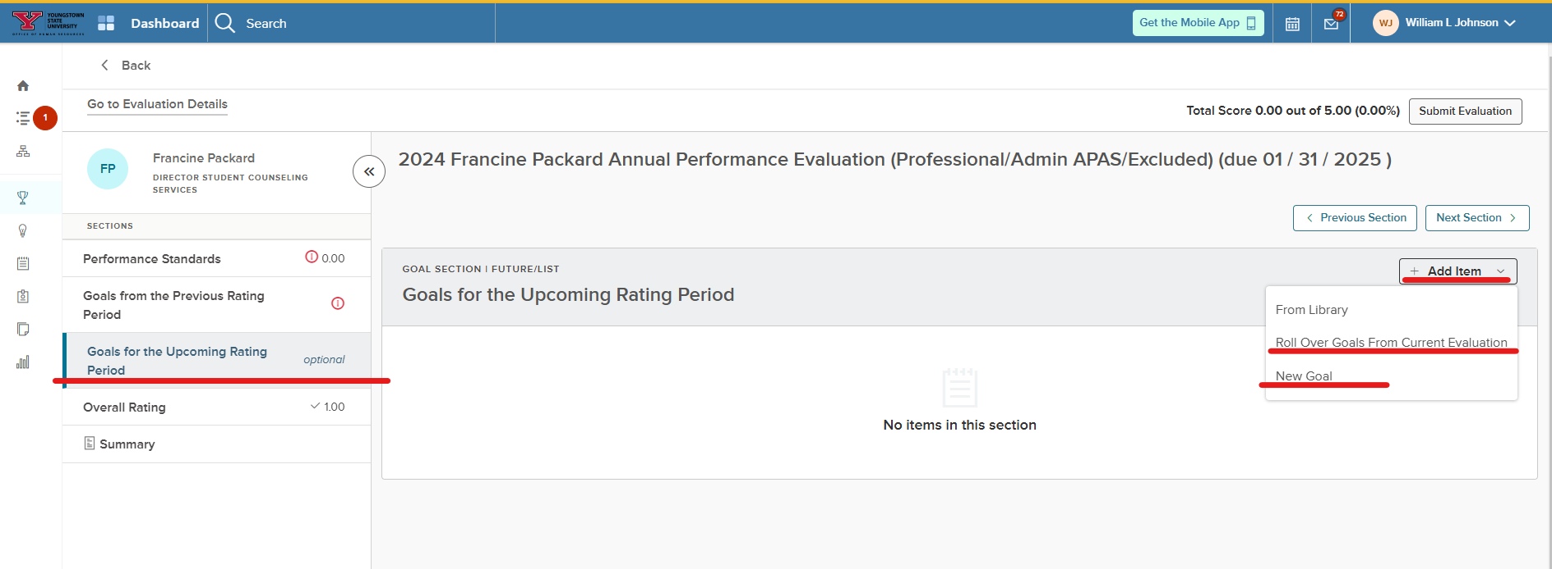
Linking Goals from Year to Year

Slide 12
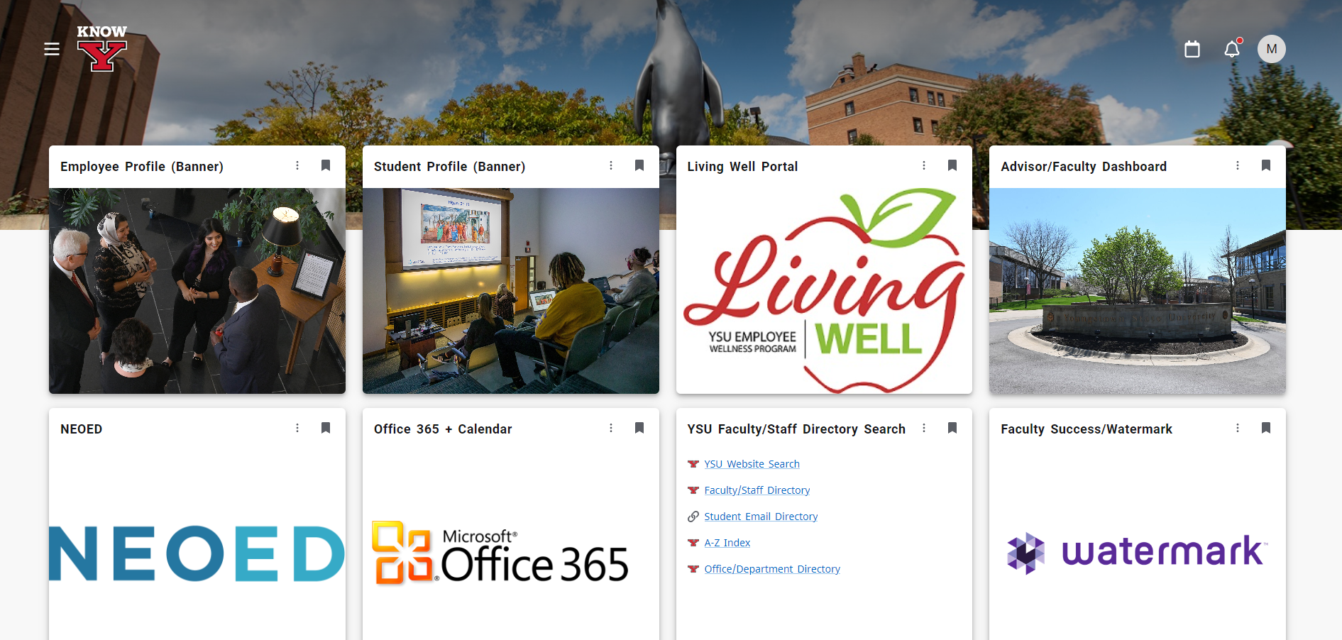
HOW TO GET STARTED
Penguin Portal: Click on the NEOED tile.

Slide 13
INSTRUCTION GUIDES
The following Instruction Guides will be available on the Training website: ysu.edu/human-resources/training
Under the Performance Management section:
Supervisor- How to set up a Performance Evaluation
Supervisor- Accessing the Evaluation and Adding Journal Entries
Employee- Acknowledges Content/Goals for Annual Performance Evaluation
Notes:
Supervisor Creates Plan
Supervisor Completes Progress Check-in
Supervisor Evaluation & Review Meeting
Employee Acknowledges Plan
Employee Self Evaluation (Optional for P/A employees)
Employee Completes Self Evaluation

Slide 14


