Slide 1
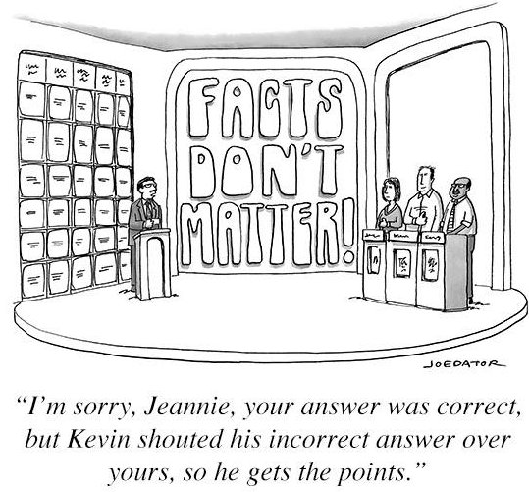
Telling Fact from Fiction: Information Literacy with Students
Monica Merrill
ITL Faculty Fellow
Criminal Justice and Consumer Sciences
October 7th, 2021

Slide 2
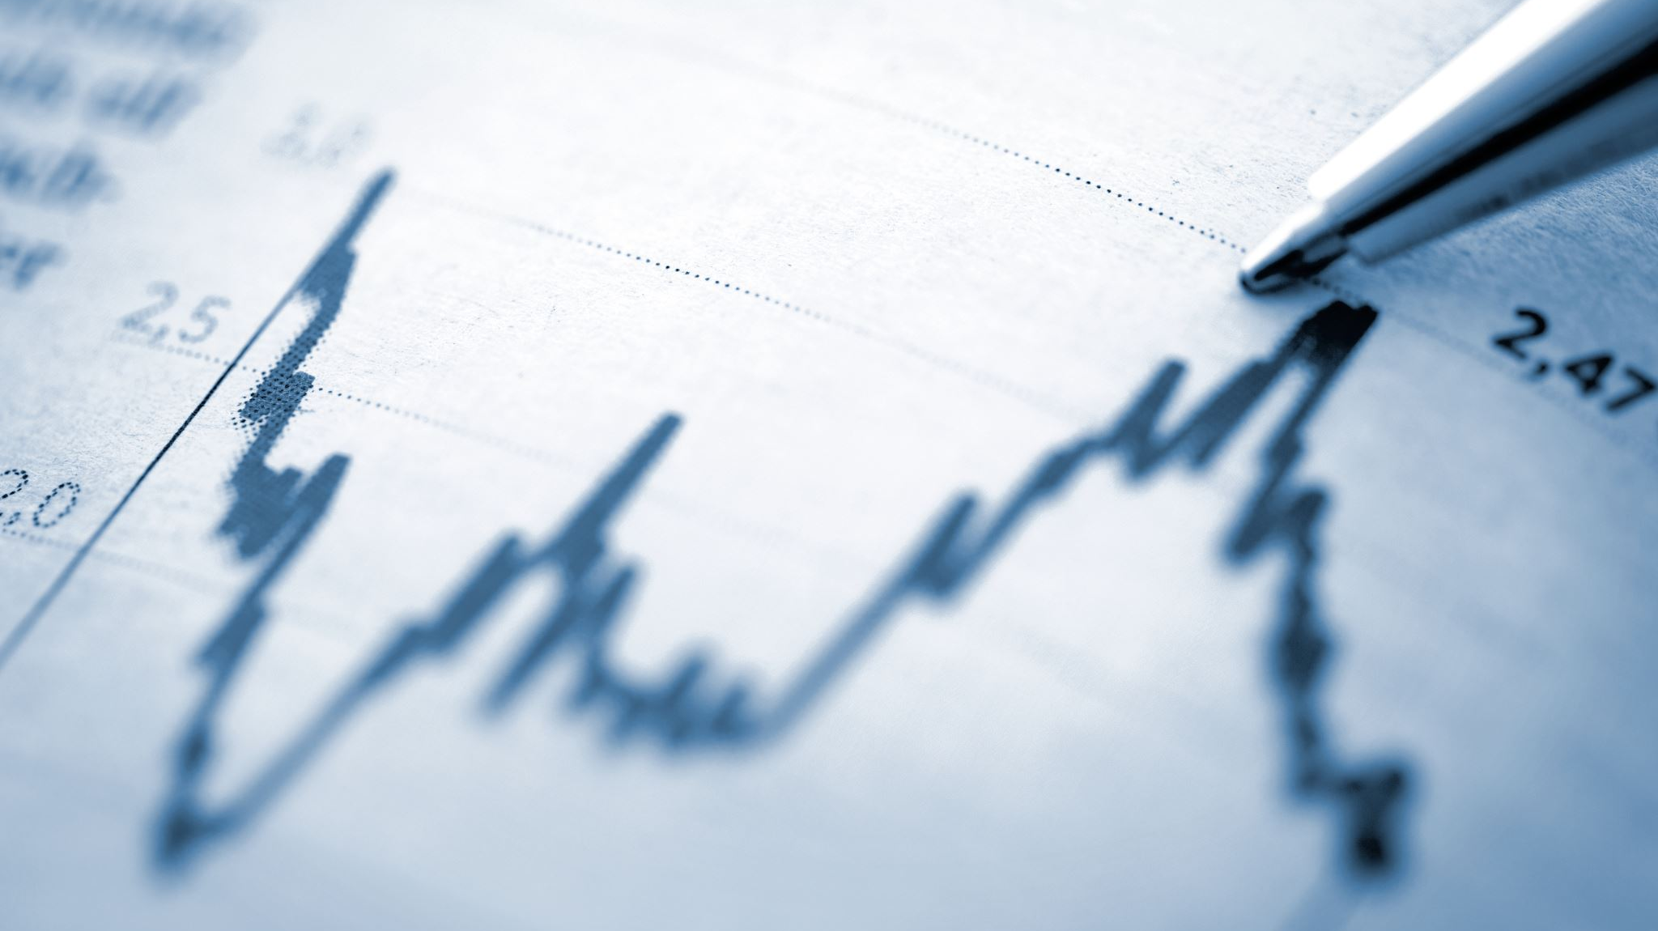
Overview
Identifying the importance of identifying facts
Examples of poor quality or misinformation
Tools to differentiate quality information
Incorporating these lessons into existing classes throughout.

Slide 3
The struggle telling fact from opinion
PEW Research Poll
Out of 10 fact/opinion statements
Only 25% correctly identified all the facts
Barely 1/3 correctly identified all the opinion statements

Slide 4
Fact vs. Opinion

Slide 5
Finding reliable information
Focus on civic reasoning
focus on what information is worthy of trust
Understand where information comes from and who is responsible for presenting it
Notes:
https://www.aft.org/sites/default/files/periodicals/ae_fall2017_mcgrew.pdf

Slide 6
”Fake News” Examples
Owned by Stormfront
Now offline

Slide 7
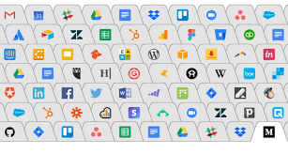
Tool #1- Lateral Reading
Lateral reading- searching for information about a source while you are reading it

Slide 8
Fake News Examples
American College of Pediatricians
SPLC Recognition

Slide 9
Tool #2: About Us
Use this tool!
Most websites will state mission, strategic plan, etc.
ACP vs. APA example

Slide 10
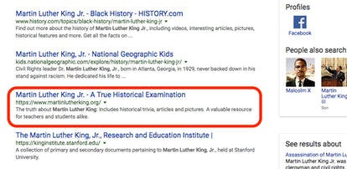
Choosing websites in searches
Understand basics of how algorithms work
Keywords
“quality”

Slide 11
Tool #3- Click Restraint
Breathe!
Search tips:
Use “keywords in order”
Use :
ysu.edu: itl
Site:edu keyword
Use – to eliminate websites or keywords
Kellogg’s strike –Kellogg’s.com
**If you are citing a terrible website, don’t link! Use martinglutherkingDOTorg

Slide 12
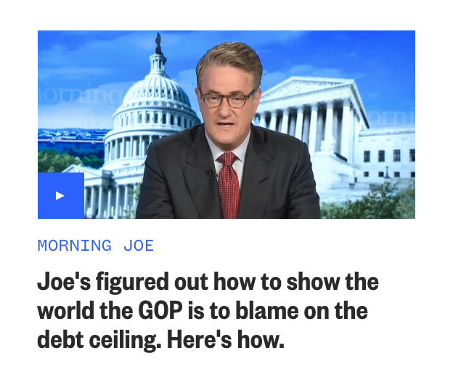
Media Bias

Slide 13
Tool #3: Identifying bias
Biased or fake news

Slide 14
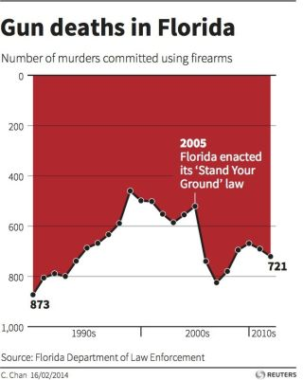
Deceiving Visual Aids
Designer- “It’s a preference”

Slide 15
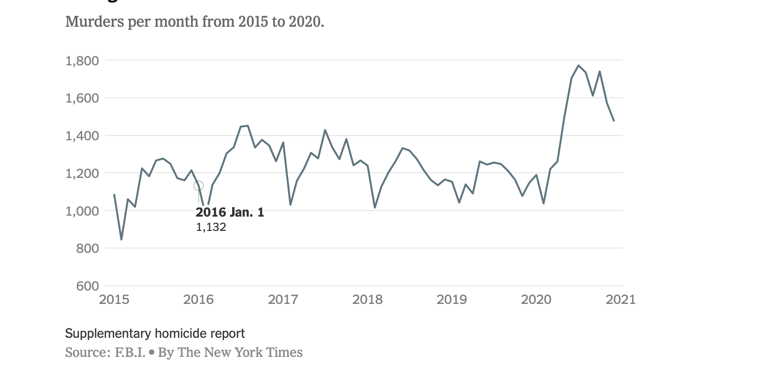
Deceiving Visual Aids

Slide 16
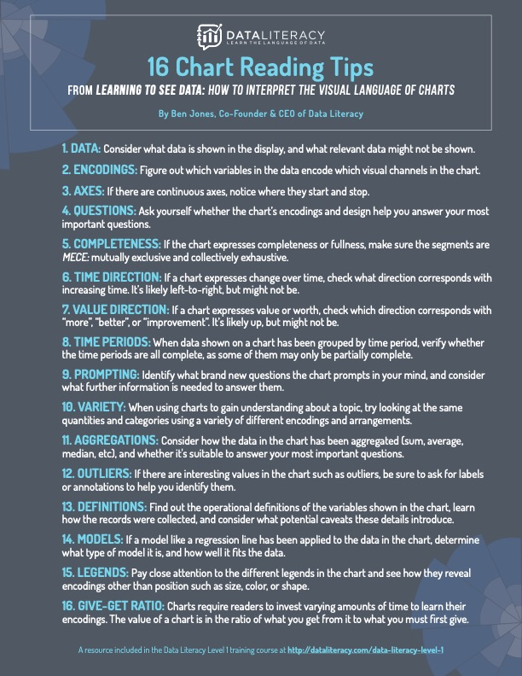
Tool #4 Visual Data Literacy
NYT What’s Going on in this graph?

Slide 17
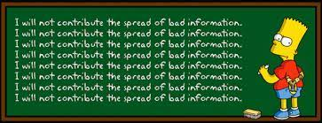
Quality of information?
Particularly important for polarizing topics
Too many examples to pick!

Slide 18
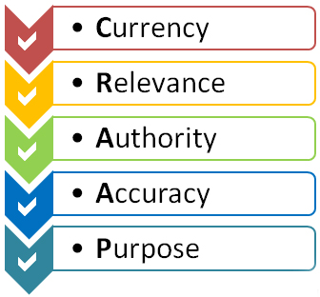
Tool #5- CRAAP Test
Fact or Crap
Recent research moving away from checklists like this
Still useful in conjunction with other tools

Slide 19
Sum up
5 Useful Tools
**Lateral reading
Use About Us Section of websites
Click Restraint
Identify Media Bias
Practice Visual Data Literacy
How can you incorporate these ideas into your courses?

Slide 20
Conclusion
Thank you!
Any questions feel free to contact me
mmmerrill@ysu.edu

