Slide 1

Division of Student Success
Academic Advising: From Strategy to Realization

Slide 2
ADVISING COMMUNITY
COLLEGE:
BCLASSE*
BCHSS*
Cliffe
STEM
WBCA
* Faculty Advisors
Special Populations:
Intercollegiate Athletics
Exploratory
Strong Start

Slide 3

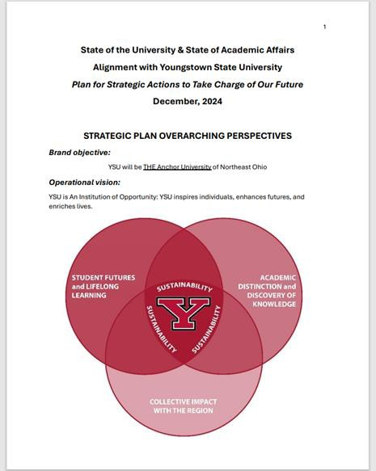
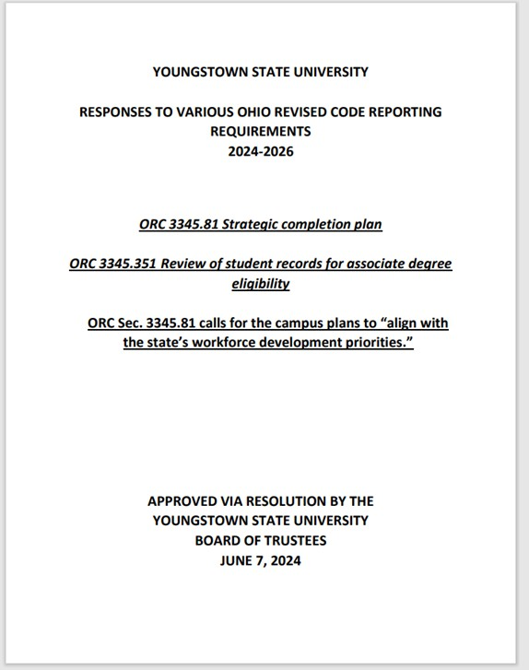
ACADEMIC MASTER PLAN

Slide 4
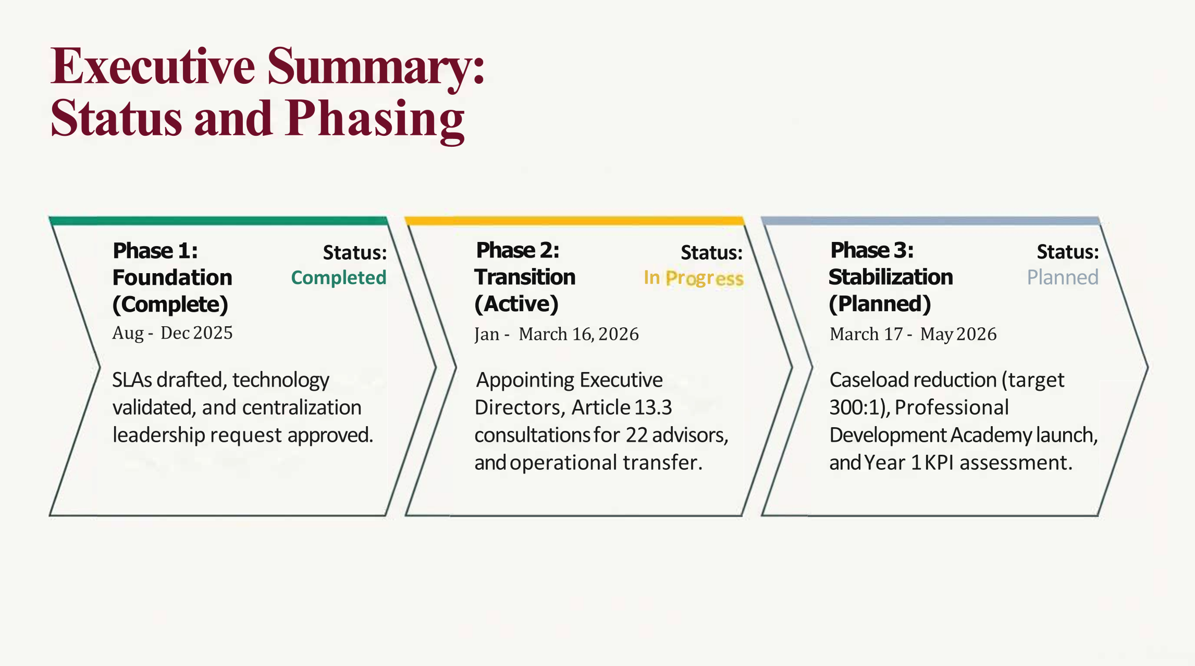
EXECUTIVE SUMMARY: STATUS AND PHASING

Slide 5

COLLABORATIVE LEADERSHIP MODEL for ACADEMIC ADVISING EMBEDDED ADVISING MODEL
Role of Embedded Advisors
Embedded advisors maintain discipline-specific connections within colleges to provide tailored student guidance aligned with programs.
Centralized Coordination
The Student Success Office offers centralized standards and coordination to ensure consistency across advising services.
Holistic Student Support
Embedded advising promotes collaboration for a holistic approach combining academic rigor with personalized support.

Slide 6

COLLABORATIVE LEADERSHIP MODEL for ACADEMIC ADVISING GUIDING PRINCIPLES
Shared Leadership Model
The framework promotes a shared leadership model ensuring clarity of roles and strong coordination across colleges.
Guiding Principles
Focuses on shared accountability, equity-focused policies, and consistent advising standards institution-wide.
Enhancing Advisor Effectiveness
Emphasizes advisor training, technology use, and professional development to improve student-centered advising.
Improving Student Outcomes
Integrates data-driven decision-making and proactive interventions to support student success and continuous improvement.

Slide 7
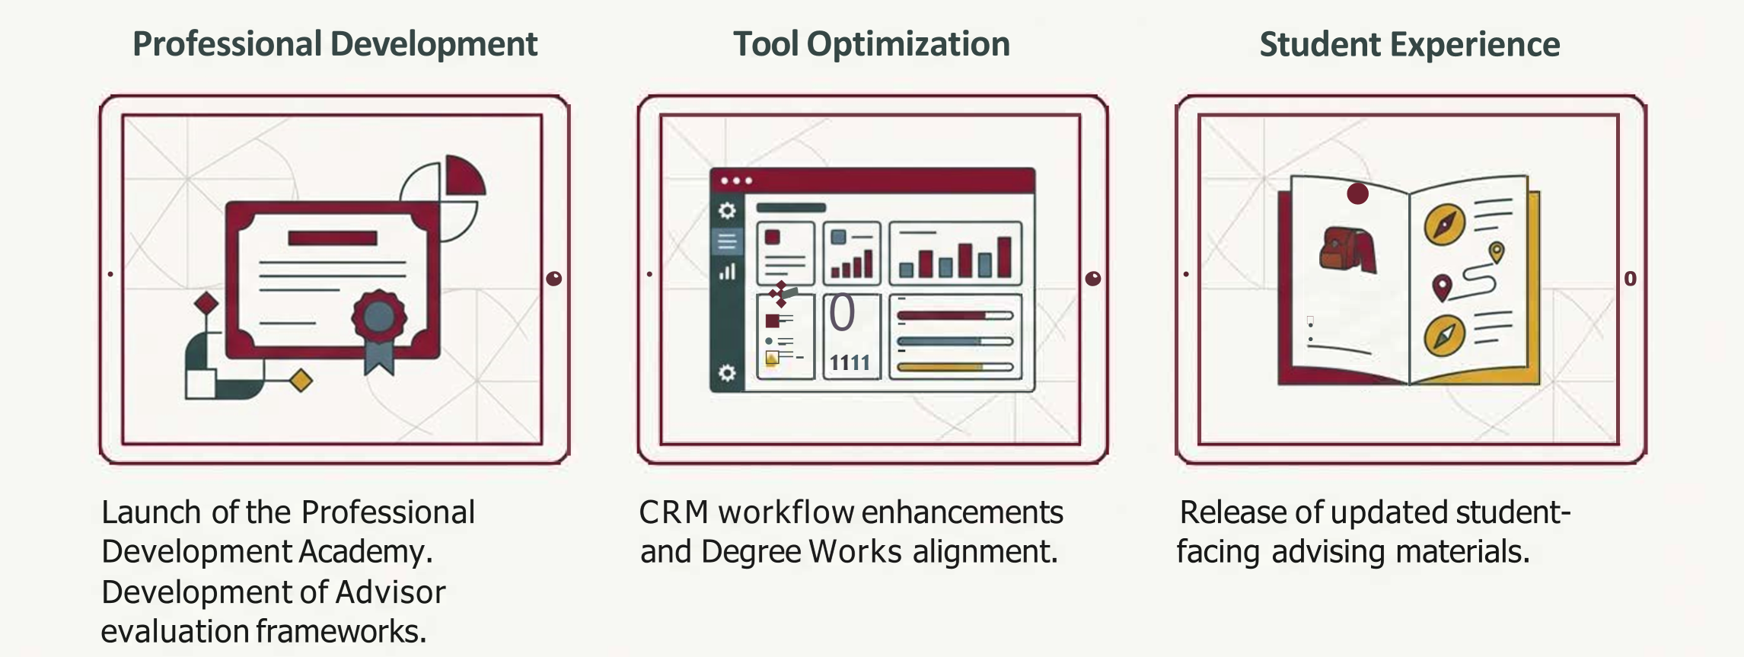
OPERATIONAL ENHANCEMENTS (SPR/SUM 2026)

Slide 8
CASELOAD STRATEGY: THE PATH TO 250:1
ACHIEVED BY HIRING NEW ADVISORS
CURRENT STATE
BENCHMARK
IDEAL STATE
325:1
300:1
250:1
ACTION PLAN:
Start hiring new academic advisors immediately following the transfer (March 17).

Slide 9

SUMMARY: A STRATEGIC INVESTMENT IN STUDENT SUCCESS
THE STRUCTURAL FOUNDATION
(AUG – DEC)
Moving toward FY27 and FY28 with a scalable, data-driven advising model designed for the ideal 250:1 caseload.
THE OPERATIONAL TRANSITION
(JAN - APR)
THE FOCUS SHIFTS TO
STABLAIZATION AND GROWTH
(MAY AND BEYOND)

