Slide 1
Academic Integrity Process Revisions
Revisions designed to…
Strengthen procedural clarity
Promote consistency
Strengthen the process while preserving faculty authority and student rights
Support fair outcomes for both faculty and students.
Notes:
Joy - Introduced Kick UP – why we are doing and specific

Slide 2
Challenges Identified
Inconsistent procedural application
Confusion around timelines and documentation
Appeals pathways needing stronger guardrails
Notes:
Betsy

Slide 3
Faculty Authority Remains Central
Faculty determine whether a violation occurred
Faculty assign academic sanctions
Notes:
Kristine

Slide 4
Key Substantive Enhancements
More Defined Timelines — Clear procedural timeframes support timely resolution and reduce uncertainty.
Structured Academic Integrity Conference — Early faculty–student engagement reinforces due process.
Guidance When Students Do Not Respond — Defined next steps allow cases to move forward while preserving appeal rights.
More Structured Hearing and Appeal Processes — Strengthens fairness, consistency, and procedural integrity.
Centralized Documentation and Case Management — Formal recordkeeping protects academic decisions.
Result: A more structured process that strengthens fairness while supporting faculty authority.
Notes:
Krsitine

Slide 5
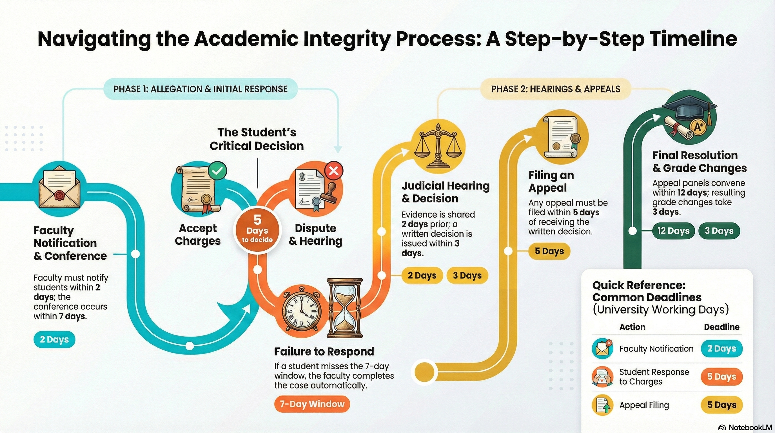
More Defined Timelines
Notes:
Betsy

Slide 6
Structured Academic Integrity Conference
Faculty to notify students within 2 days of allegations inviting them to a conference.
Prior to scheduling the meeting, faculty will confirm with Office of Community Standards and Student Conduct if this is the first violation.
Conference should occur within 7 university working days of written notification to student.
Following the meeting, the students has 5 university working days to sign the form
Notes:
Kristine

Slide 7
Guidance When Students Don’t Respond
If student does not respond the faculty member may determine the meeting time for the academic integrity conference.
If the student does not attend the conference, within 7 university working days the following will occur:
    Form is routed from Faculty, Chair, Dean to Office of Academic Affairs.
    Judicial Chair of Academic Grievance subcommittee may sign the form and sent notice to the student.
    The appeals process remains in effect.
Notes:
Krsitine

Slide 8
More Structured Hearing Process
Committee Makeup
Judicial Chair – Associate Provost for Academic Administration
Faculty Members – appointed by senate and/or serve on student conduct board (3 faculty)
Undergraduate Students – conduct board members, trained, min. GPA (2.0 UG/ 3.0 GRAD)
Evidence Submission
Student has 7 days to submit evidence to judicial chair upon receiving notification of hearing
Judicial Chair submits evidence to the grievance subcommittee members within 2 university working day of the scheduled hearing.
Parties Directly Involved
Faculty/Student (faculty may have substitute if needed)
Department Chairperson (optional)
College Dean (optional)
Academic Grievance Subcommittee Hearing Panel Members
Graduate Faculty (3) / Student (1) as needed
Notes:
Joy

Slide 9
Centralized Documentation and Case Management
Both parties informed of hearing panel’s decision within 3 university working days.
A file of all pertinent hearing documents will be filed within the Office of Academic Affairs.
Resulting grade changes are signed by faculty member, chair and dean within 5 university working days.
Appeals documentation and decision letters are filed in the Office of Academic Affairs.
Notations of previous and multiple academic integrity violations will be filed within the Office of Academic Affairs.
Notes:
Kristine

Slide 10
More Structured Appeals Process
Judicial Chair forwards written appeal on to the academic senate executive committee.
Committee hears appeal within 2 university working days.
Appeal Committee Members are:
    Academic Senate Chair
    Academic Senate Vice Chair
    Academic Senate Secretary
    Academic Senate Parliamentarian
    Academic College Representation
    Student Government Association President
Notes:
Betsy

Slide 11
Appellate Hearing Panel
Member of the Academic Senate Executive Committee makeup the Appellate panel.
Chair of this panel informs both parties within 5 university working days of decision.
Written letter of decision prepared and signed by chair of Appellate panel – letter forwarded to student, faculty member, office of community standards and office of academic affairs within 5 days of decision.
Notes:
Krsitine

Slide 12
We welcome your feedback!
Stay tuned for an email with the revised document.
Please review and send comments via the electronic feedback form that will be included in the email.
Please complete the feedback form by Feb, 20th -
Notes:
Feedback form will be coming from Student Affairs along with redline version of the AI Section in the Code of Conduct
Sub committee Academic Integrity Committee of Academic Senate - Matt Omansky – currently reviewing

Slide 13
Moving Forward
This collaborative work is designed to…
Protect academic standards
Support faculty
Ensure equitable treatment of students
Strengthen institutional integrity
Notes:
Joy, Kristine and Besty

