Slide 1



SB1 Syllabus Compliance Training Updates
Academic Senate Update
April 22, 2026

Slide 2
Summer 2026 Syllabus Submission/Approval Dates for YSU Faculty
Session(s) | Submission | Approval
Full Term | May 15, 2026 | May 22, 2026
First 7 Weeks & AOP Summer 1 | May 15, 2026 | May 22, 2026
Second 7 Weeks & AOP Summer 2 | July 3, 2026 | July 10, 2026

Slide 3
Fall 2026 Syllabus Submission/Approval Dates for YSU Faculty
Session(s) | Submission | Approval
Full Term | August 17, 2026 | August 21, 2026
First 7 Weeks & AOP Fall 1 | August 17, 2026 | August 21, 2026
Second 7 Weeks & AOP Fall 2 | October 12, 2026 | October 16, 2026

Slide 4
Upcoming and Ongoing Trainings
Week of | Session Dates | Time
April 27, 2026 | Tues, Apr 28 & Thurs, Apr 30 | 3:00–4:00 PM
May 4, 2026 | Mon, May 4 & Wed, May 6 | 4:00–5:00 PM
May 11, 2026 | Mon, May 11 & Tues, May 12 | 4:00–5:00 PM
May 25, 2026 | Sessions held this week | TBD
June 8, 2026 | Sessions held this week | TBD
June 22, 2026 | Sessions held this week | TBD
July 6, 2026 | Sessions held this week | TBD
July 20, 2026 | Sessions held this week | TBD
August 3, 2026 | Sessions held this week | TBD

Slide 5



Additional Training Resources
Trainings will be recorded
IT Training Services is creating a CourseLeaf SYL Toolkit (under development)
IT Training Services will offer “drop in” hours throughout the summer – virtually and in person.

Slide 6
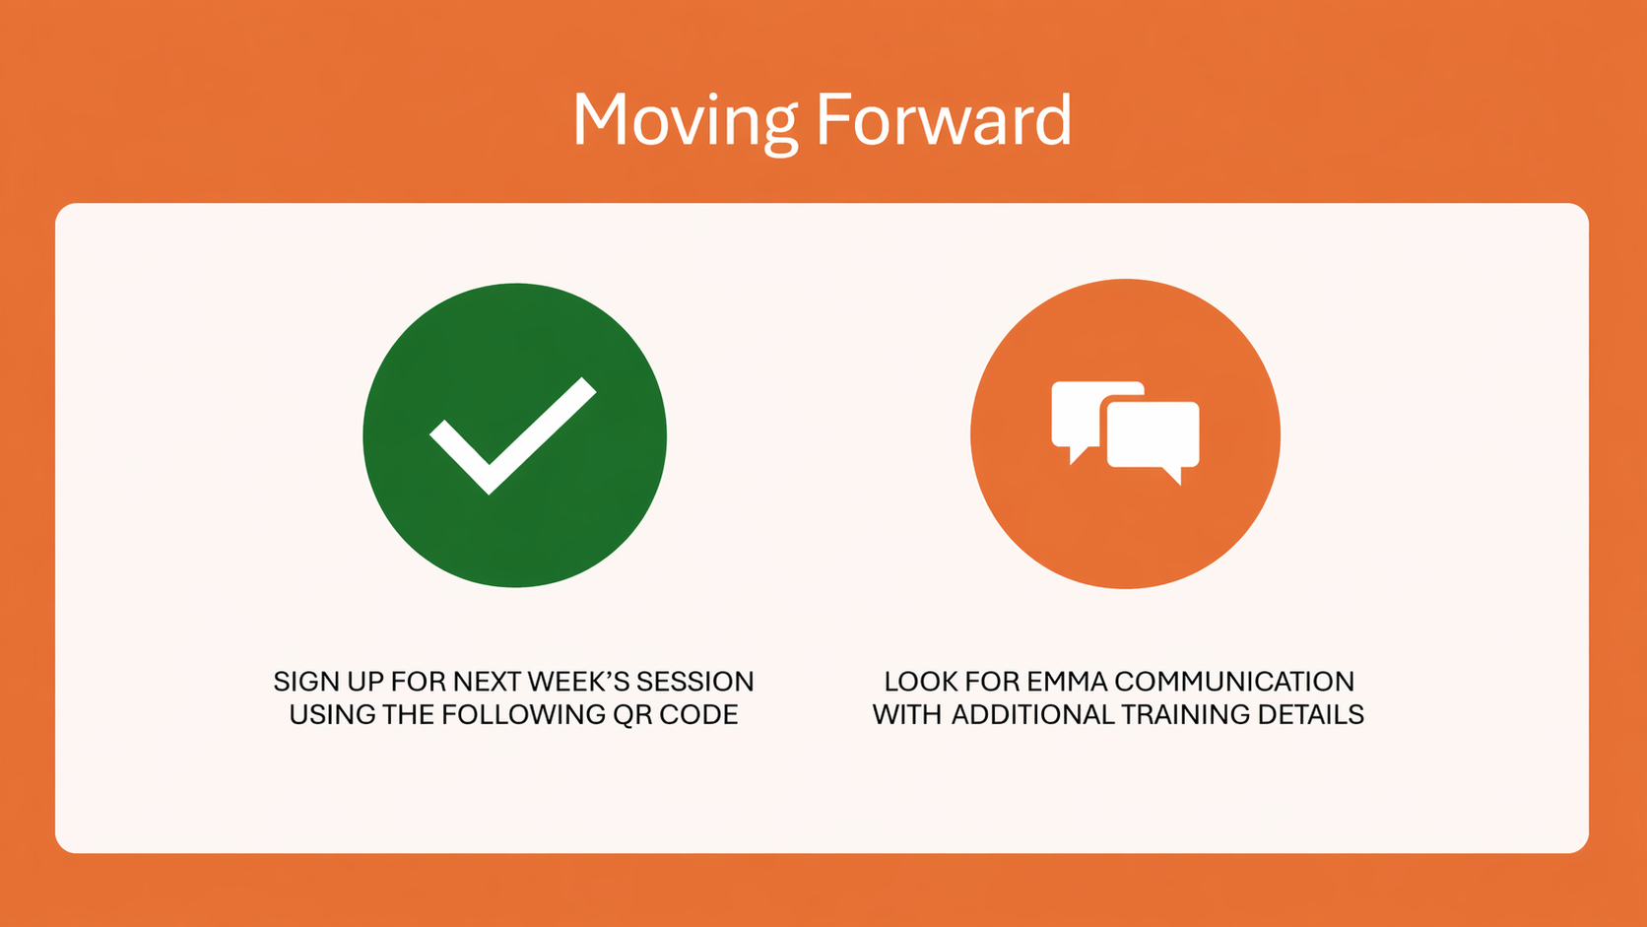

Slide 7
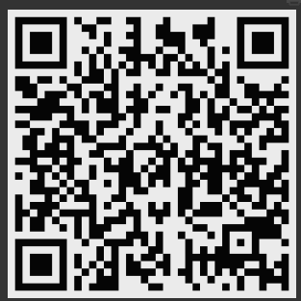
Register or Drop In
Register to attend.
or
Drop In at the scheduled times:
https://ysu.webex.com/meet/rsdonaldson

