Slide 1
Use of Pronouns in the Recommended Syllabus
Austin Browne
Williamson College of Business

Slide 2
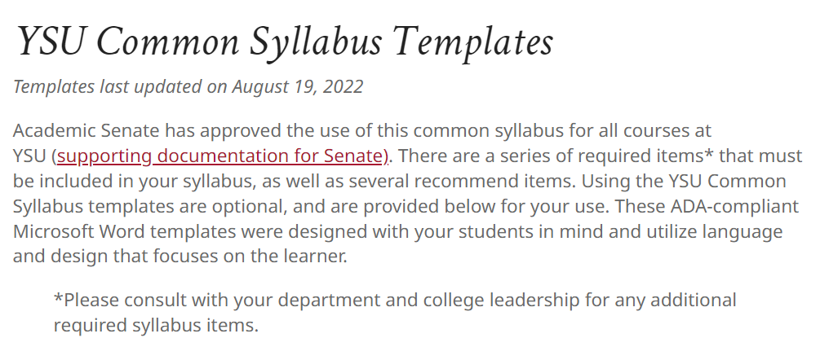
*Taken from the YSU Academic Senate webpage

Slide 3
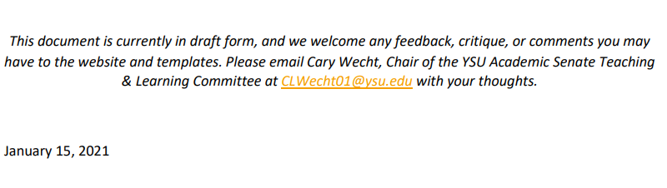
Supporting Documentation
Accurately recognizes that the recommended syllabus is not required
Also notes that is a draft, indicating it has not been passed
A browse through previous minutes seems to confirm this

Slide 4
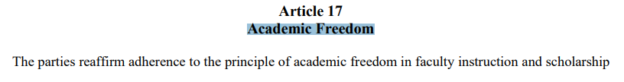
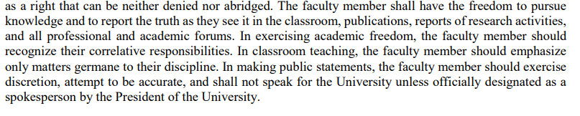

Slide 5
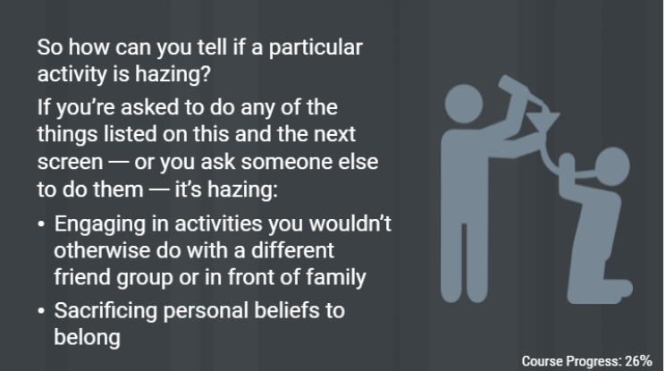
Inclusion of this seems to cater to a particular ideology
Has encouraged professors to ask students their pronouns
Students have been made to feel uncomfortable and fear retribution if they decline to answer

Slide 6
Questions
How did this end up as an official recommendation of the Senate?
How is the inclusion of pronouns on a syllabus advancing the academic mission of the university?
Why are all minority status not included in the syllabus?

