Slide 1
Academic Excellence and Student Success:
Strategic Planning Framework
Moataz M. Abdelrasoul, Undergraduate Student, Pre-Law and Political Science major.
Coskun Bayrak, Chair and Professor of Computer Science and Information Services.
Claire Berardini, Associate Provost for Student Success.
Kristine Blair, Dean, College of Liberal Arts and Social Sciences and professor of English.
Amy Cossentino, Director, Honors College.
Amy Crawford, Professor of Telecommunication Studies.
Chet Cooper, Chair of Academic Senate and Professor of Biological Sciences.
Dana Davis, Chair of Social Work and Assistant Professor of Social Work.
Tim Francisco, Professor of English.
Rodney Harden, YSU-ACE Vice President and Network Technician.
Jacci Johnson, Assistant Director of Undergraduate Admissions.
Sepideh Khavari, Lecturer, Department of Mathematics and Statistics.
Ken Learman, Professor of Physical Therapy.
Jenn Pintar, Associate Provost for Academic Administration and Professor of Kinesiology and Sport Science.
James “Ted” Roberts, YSU Board of Trustees and Senior Counsel, Roth, Blair, Roberts, Strasfeld & Lodge.
Molly Seals, YSU Board of Trustees and System Vice President of Human Resources Program Delivery, Mercy Health.
Mike Sherman, Special Assistant to the President.
AJ Sumell, YSU-OEA President and Professor of Economics.

Slide 2
Academic Excellence & Student Success
Strategic Planning Framework
Strategic Planning Overview (handout)
Strategic Planning: Academic Excellence Framework
Academic Excellence and Student Success: A view from the Office of Academic Affairs
Breakout Session
Reports
Dean submits timeline to OAA by x date/time

Slide 3
Board of Trustees
President
Inclusion & Diversity
STUDENT SUCCESS
Student Affairs
ACADEMIC
EXCELLENCE
Research
Recreation & Athletics
Finance & Administration
Human Resources
Marketing & Communication
3

Slide 4
ENROLLMENT IS:
MATRICULATION
RECRUITMENT
M
C
2
R
+
+
P
COMPLETION
PERSISTENCE
CAREER

Slide 5
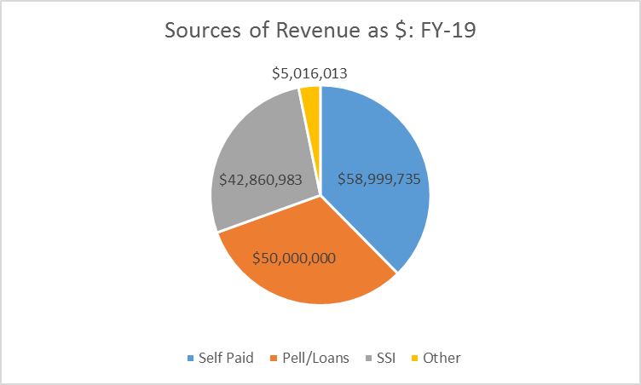
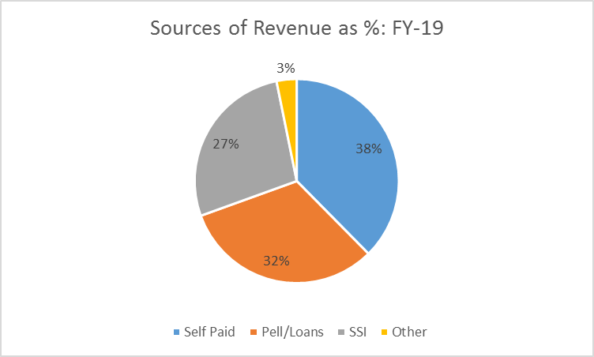
A REALITY

Slide 6
Persistence Success=Student Success=YSU Success
STRATEGIC INVESMENT
REVENUE
EXPENSE

Slide 7
STRATEGIC PLANNING
Strategic Plan is enabled via a budget aligned with the Plan
Spring 2020
  Board of Trustees Endorse the Plan and Budget
    Optimized the use of current resources
      Support areas
      Academic areas
    Basis for strategic investment
  Spring 2021 repeat the above

Slide 8
Academic Excellence Strategic Planning Framework
Aligning Resources with Strategic Priorities
Fall 2018
Who are we?
Value proposition
Spring 2019
SWOT
Where do we go?
New value proposition
Summer/Fall 2019
Academic Optimization
Spring 2020
Optimize FY-21 resources with Strategic Priorities
Strategic Plan
Academic Excellence Plan
College Plan
Department Plan
Program Plan

Slide 9
Quality
Distinction
College
Sustainable
Student Success
Scholarship
Academic Excellence
Student Success
Department
YSU STRATEGIC PLAN
Engagement
Regionally
Relevant
Nationally
Distinctive
Stimulating
Enabling
Teaching
Research
Connecting
Program
Globally
Connected
Service

Slide 10
Insert Name of Program/Department/College/DAA
Attributes of Academic Excellence and Student Success
Points of Pride
Foundational qualities of academic excellence
Distinction that has emerged from these foundational qualities of academic excellence
Activities/initiatives to improve student access and success
Faculty accomplishments to support quality and distinction
Community impact
Meaningful and impactful collaborations across departments, employers, and community organizations
Mission and vision (if these already exist)
Elevator speech

Slide 11
BREAK OUT SESSION BY COLLEGE
Fall Strategic Planning
How will we intentionally engage the faculty and staff in the conversation that results in genuine responses to the questions?
What will be the approach/timeline for interacting with:
  Program faculty
  Departments/Schools
  College
Update the group

Slide 12
Insert Name of Program/Department/College/DAA
Academic Year
Teaching
Quality
Student Success
Research
Distinction
Scholarship
Focus Here
Service
Sustainable
Engagement
Insert Date

Slide 13
Insert Name of Program/Department/College/DAA
Points of Pride
List points of pride that link to academic quality or distinction, student success, or community engagement (likely ~5-8)

Slide 14
Insert Name of Program/Department/College/DAA
Points of Distinction (differentiate UG and G as appropriate-could be a separate similar slide)
ELEVATOR SPEECH
State why a prospective student should choose a program or a program in the college or at YSU based upon academic quality or distinction, student success, or community engagement
List attributes of compelling distinction that exist
  Xxx
  Xxx

Slide 15
Insert Name of Program/Department/College/DAA
Key Strategies (differentiate for UG and G as appropriate- could be a separate similar slide)
List the key, foundational or baseline strategies that exist without which distinction would not be possible
  Xxx
  Xxx

Slide 16
Insert Name of Program/Department/College/DAA
Efforts Related to Student Success (differentiate UG and G as appropriate-could be a separate similar slide)
List initiatives or activities undertaken known to improve student success and indicate in what way and by how much
  Xxxx
  Xxxx

Slide 17
Insert Name of Program/Department/College/DAA
Faculty Accomplishments
17

Slide 18
Insert Name of Program/Department/College/DAA
Efforts Related to Impacting the Community
List initiatives or activities undertaken known to impact the community and indicate in what way and by how much-if possible (that the community would agree with such assessment)
  Xxxx
  Xxxx

Slide 19
Insert Name of Program/Department/College/DAA
Efforts Related to Collaborations Across Campus
List initiatives or activities undertaken that are collaborative in nature with other academic units or support areas at YSU indicating the level of impact
  Xxxx
  Xxxx

Slide 20
Insert Name of Program/Department/College/DAA
If these exist….
MISSION: xxxxxxxxxxxxxxxxxxxxxxxxxxxxxxxxxxxxxxx
VISION: xxxxxxxxxxxxxxxxxxxxxxxxxxxxxxxxxxxxxxx

Slide 21
Insert Name of Program/Department/College/DAA
Efforts Related to xxxx
This is an optional slide that each area may choose to use to highlight some other aspect of the area that warrants attention

