Slide 1
Note for instructors:
If you make significant improvements/additions to this slide deck, I would love for you to share your improvements with me! (a.waggoner@utoronto.ca)
These slides provide a summary of some recent research on the use/access of technology (e.g., laptops, phones) during class time and study sessions.
This is not a comprehensive list of all research done in this area!
The slides themselves have limited text on them, as they are meant to be ‘ready to show’ to students in the context of a lecture. However, I have included additional information (including full abstracts of key papers referenced) in the notes sections of the slides.
While the slides focus on results, I also highly recommend using this opportunity to discuss research methods, potential confounds, appropriate inference, etc.!
Notes:
Additional note: In the notes sections, I have also included some suggestions on how to present the material (e.g., questions to pose to students, etc.).

Slide 2
Additional Resources:
For instructors (from the Learning Scientists):
Links to pro & con opinion pieces on cell phone use in the classroom: http://www.learningscientists.org/blog/2017/9/17/weekly-digest-77
Guest post on Technology in the Classroom:
http://www.learningscientists.org/blog/2017/9/5-1
For students (a wonderful article that includes the technology advice advocated here, as well as a lot more!):
Putnam et al. (2016). Optimizing learning in college: Tips from cognitive psychology. Perspectives on Psychological Science, 11, 652-660. https://uwaterloo.ca/psychology/sites/ca.psychology/files/uploads/files/howtosucceedinuniversity.pdf

Slide 3

Making Informed Decisions: Laptops, Smartphones, and Your Studies

Slide 4

Notes:
Our current technologies, like any tool, have the potential to greatly enhance our lives or make them miserable.
E.g., A hammer is a wonderful tool to have when we need to put a nail into a wall, but might be downright infuriating if we are trying to cut down a tree.
Now, imagine that you are watching someone trying to cut down a tree with a hammer. And there is a saw right there in front of them. You would want to suggest the saw, right? Maybe they haven’t noticed it or they don’t realize what it can do. This is what I want to do here. Your electronic devices are not the enemy, just like the hammer isn’t the enemy. It’s just not ubiquitously helpful.
I just want to make sure that we are all making good, informed decisions about when and how best to use these things!

Slide 5

Laptop Use in the Classroom
Laptops are (gasp!) not always used solely for note-taking
Email, unrelated websites, videos, shopping, social media, etc.
School-unrelated laptop use during class time has been associated with lower academic satisfaction, lower end-of-semester GPAs, and lower course performance relative to classmates (Gaudreau, Miranda, & Gareau, 2014)
Notes:
Ask or survey students what they have used their laptop for during class, and/or to estimate what proportion of class time they end up doing non-school related things
Who has a laptop with them right now? Who has a window open that is not school related?
Ask the students what type of study this is; what are some potential third variables? (note: see abstract for list of variables the authors controlled for)
ARTICLE: Gaudreau, P., Miranda, D., & Gareau, A. (2014). Canadian university students in wireless classrooms: What do they do on their laptops and does it really matter? Computers & Education, 70, 245-255.
AVAILABLE: https://doi.org/10.1016/j.compedu.2013.08.019
ABSTRACT: Two studies were conducted to examine what undergraduate students do on their laptops during class time and the extent to which laptop usage behaviors are associated with academic success. In Study 1, a sample of 1129 students from a Canadian university completed a survey measuring prototypical behaviors emitted on laptops during class time. Results of factor analyses indicated that laptop behaviors can be regrouped in two dimensions: School related and school unrelated laptop utilization. School unrelated laptop behaviors were significantly associated with lower levels of self-reported academic achievement and satisfaction. School related laptop behaviors were positively associated with academic satisfaction. These results were invariant across different faculties on campus. In Study 2, another sample of 88 students was recruited to examine the longitudinal association between laptop behaviors and semester grade point average obtained at the end of the semester. Results of Study 2 showed that school unrelated laptop behaviors were prospectively associated with lower semester grade point average, even after controlling for a series of potentially confounding influences (i.e., self-regulation failure, motivational deficit, disorganized learning, internet addiction, and school disenchantment). Overall, these results provide theoretically important support to suggest that in-class laptop utilization is a unique and contemporary mode of learning that should not be treated as an epiphenomenon merely accountable and reducible to other sources of psychological influences.

Slide 6
Laptop Use in the Classroom: Multitasking Sana, Weston & Cepeda, 2013
Simulated classroom environment (45 minute ‘introduction to meteorology’ lecture)
Multitasking condition: given 12 online tasks similar to those that students regularly engage in (e.g., answering a question that can be found with a relatively quick Google search)
No multitasking condition: Just used their laptops to take notes
Lecture was immediately followed by a comprehension test (both knowledge and application questions)
Notes:
ARTICLE: Sana, F., Weston, T.., & Cepeda, N.J. (2013). Laptop multitasking hinders classroom learning for both users and nearby peers. Computers & Education, 62, 24-31.
AVAILABLE: https://doi.org/10.1016/j.compedu.2012.10.003
ABSTRACT: Laptops are commonplace in university classrooms. In light of cognitive psychology theory on costs associated with multitasking, we examined the effects of in-class laptop use on student learning in a simulated classroom. We found that participants who multitasked on a laptop during a lecture scored lower on a test compared to those who did not multitask, and participants who were in direct view of a multitasking peer scored lower on a test compared to those who were not. The results demonstrate that multitasking on a laptop poses a significant distraction to both users and fellow students and can be detrimental to comprehension of lecture content.
Experiment 2: paper and pencil, in view of paper and pencil peers or multitasking peers → no difference in quality of notes taken, but those in view of a multitasking peer performed 17% lower on the comprehension quiz

Slide 7
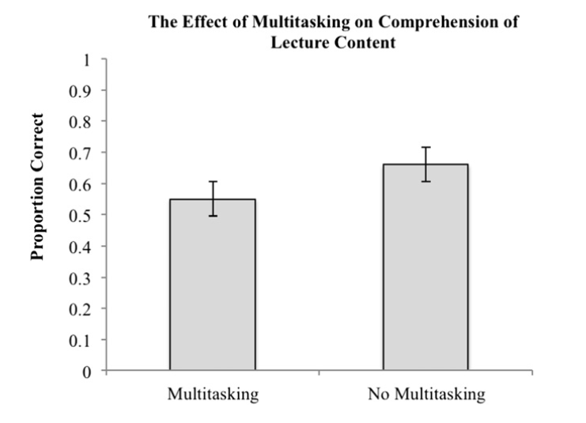
The multitasking students scored an average of 11% lower on the test!
The notes taken by the multitaskers were also of poorer quality – e.g., missing the verbal information provided by the lecturer not included on the lecture slides
(Fig. 1 from Sana, Weston & Cepeda, 2013)
Notes:
At this point students might argue (or you can bring up) that maybe if they had had time to study (tests aren’t normally given immediately after a lecture), the difference would go away and it wouldn’t matter what they were doing during class time – then put up the finding regarding the quality notes, and say that we will return to this issue in a moment.
Note: Notes from the multitasker were rated by a blind experimenter most familiar with the lecture information and scored from 1 (missing things from slides, disorganized, etc.) to 5 (all verbal and written information included in notes). 3 indicates notes that include all information from the slides themselves. Multitaskers: M = 2.7, SD = 1.2; Non Multitaskers: M = 4.1, SD = 1.0)

Slide 8
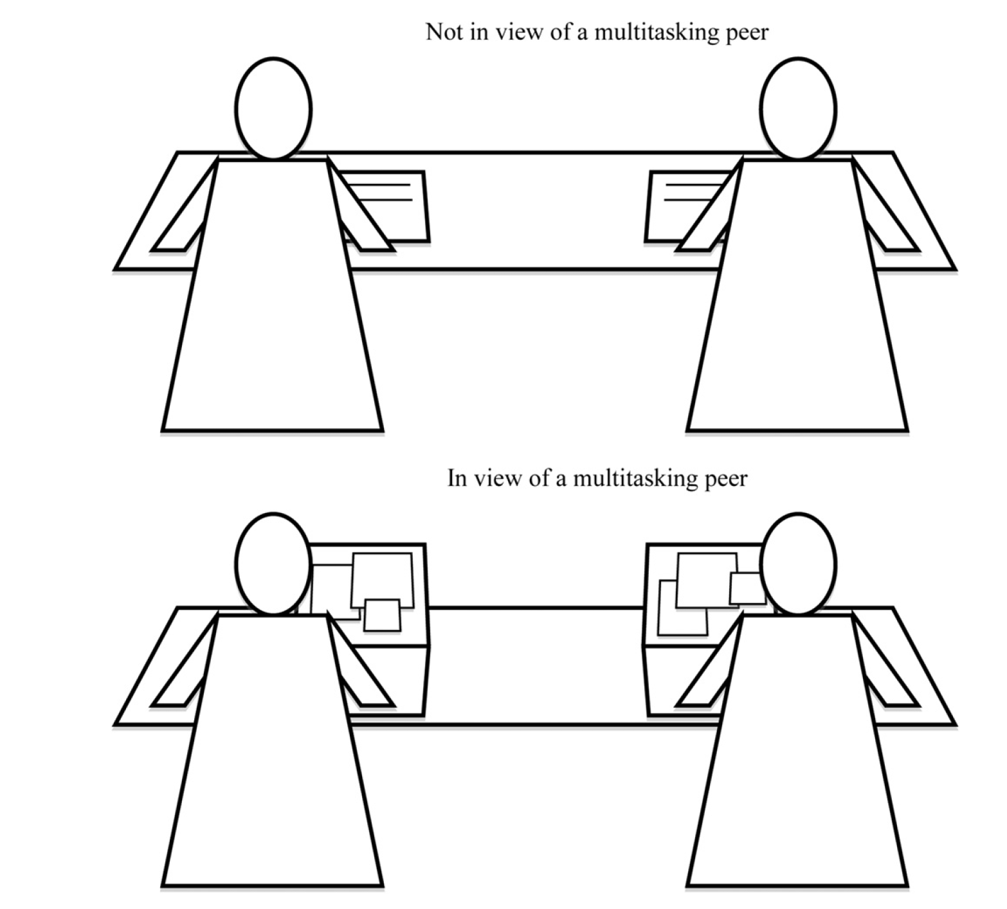
Laptop Use in the Classroom: Multitasking Sana, Weston & Cepeda, 2013
Study 2: Examined effect of multitasking on nearby peers (rather than the multitaskers themselves)
Participants themselves took paper-and-pencil notes (no multitasking)
Participants in both conditions took notes of similar quality
How well do you think each group performed on the test?
(Fig. 2 from Sana, Weston & Cepeda, 2013)
Notes:
ARTICLE: Sana, F., Weston, T.., & Cepeda, N.J. (2013). Laptop multitasking hinders classroom learning for both users and nearby peers. Computers & Education, 62, 24-31.
AVAILABLE: https://doi.org/10.1016/j.compedu.2012.10.003
ABSTRACT: Laptops are commonplace in university classrooms. In light of cognitive psychology theory on costs associated with multitasking, we examined the effects of in-class laptop use on student learning in a simulated classroom. We found that participants who multitasked on a laptop during a lecture scored lower on a test compared to those who did not multitask, and participants who were in direct view of a multitasking peer scored lower on a test compared to those who were not. The results demonstrate that multitasking on a laptop poses a significant distraction to both users and fellow students and can be detrimental to comprehension of lecture content.
Experiment 2: paper and pencil, in view of paper and pencil peers or multitasking peers → no difference in quality of notes taken, but those in view of a multitasking peer performed 17% lower on the comprehension quiz

Slide 9
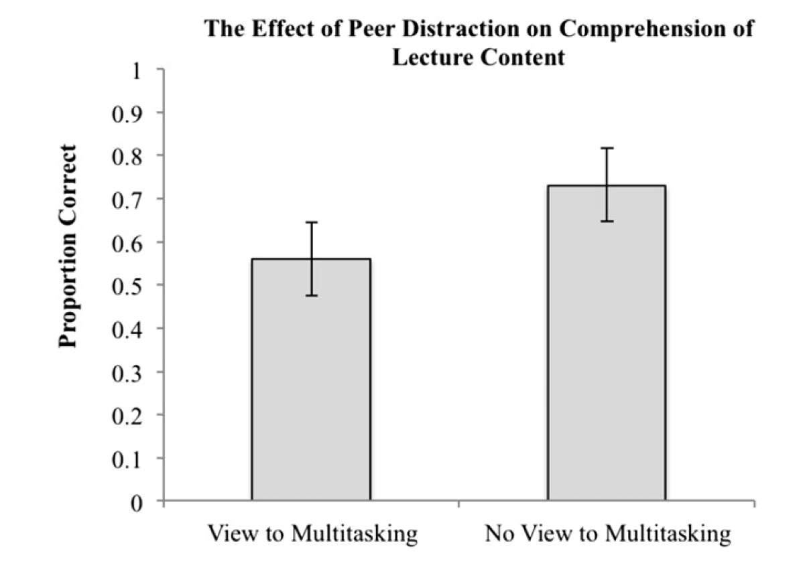
Students in view of multitasking peers scored 17% lower on the test!
Study 2: Examined effect of multitasking on nearby peers (rather than the multitaskers themselves)
Participants themselves took paper-and-pencil notes (no multitasking)
Participants in both conditions took notes of similar quality.
How do you think they did on the test?
(Fig. 1 from Sana, Weston & Cepeda, 2013)
Importantly, these students did NOT realize the effect that others’ behavior was having on them – e.g., they believed their learning was “barely hindered” by their peers.
(Fig. 3 from Sana, Weston & Cepeda, 2013)
Notes:
ARTICLE: Sana, F., Weston, T.., & Cepeda, N.J. (2013). Laptop multitasking hinders classroom learning for both users and nearby peers. Computers & Education, 62, 24-31.
AVAILABLE: https://doi.org/10.1016/j.compedu.2012.10.003
ABSTRACT: Laptops are commonplace in university classrooms. In light of cognitive psychology theory on costs associated with multitasking, we examined the effects of in-class laptop use on student learning in a simulated classroom. We found that participants who multitasked on a laptop during a lecture scored lower on a test compared to those who did not multitask, and participants who were in direct view of a multitasking peer scored lower on a test compared to those who were not. The results demonstrate that multitasking on a laptop poses a significant distraction to both users and fellow students and can be detrimental to comprehension of lecture content.
Experiment 2: paper and pencil, in view of paper and pencil peers or multitasking peers → no difference in quality of notes taken, but those in view of a multitasking peer performed 17% lower on the comprehension quiz

Slide 10
Laptop Use in the Classroom: Notetaking Mueller & Oppenheimer, 2014 (updated 2018)
What if you use your laptop solely for notetaking?
Simulated classroom environment (watched 5 TED Talks), instructed to take notes “as they normally would in the classroom” either using a laptop or a notebook (longhand notes)
Note: laptops were disconnected from the Internet!
After distractor tasks and a 30-min delay, participants took a test that included factual-recall and conceptual-application questions based on the talks
Notes:
Okay, so multitasking on your computer during class is likely detrimental to both your learning and the learning of those seated around you. So, what if you ONLY use your laptop for notetaking?
ARTICLE: Mueller, P. A., & Oppenheimer, D. M. (2014). The pen is mightier than the keyboard: Advantages of longhand over laptop note taking. Psychological Science, 25, 1159–1168. ACCESS HERE for 2018 Corrigendum: DOI: https://doi.10.1177/0956797618781773
AVAILABLE: http://journals.sagepub.com/doi/abs/10.1177/0956797614524581
ABSTRACT: Taking notes on laptops rather than in longhand is increasingly common. Many researchers have suggested that laptop note taking is less effective than longhand note taking for learning. Prior studies have primarily focused on students’ capacity for multitasking and distraction when using laptops. The present research suggests that even when laptops are used solely to take notes, they may still be impairing learning because their use results in shallower processing. In three studies, we found that students who took notes on laptops performed worse on conceptual questions than students who took notes longhand. We show that whereas taking more notes can be beneficial, laptop note takers’ tendency to transcribe lectures verbatim rather than processing information and reframing it in their own words is detrimental to learning.

Slide 11
Laptop Use in the Classroom: Notetaking Mueller & Oppenheimer, 2014 (updated 2018)
Study 1: Laptop note-takers performed worse on conceptual-application questions; took longer notes, but more transcription-like (taking notes verbatim)
Study 2: Specifically instructed to not take notes verbatim. Laptop note-takers still performed worse, and still took more verbatim notes than longhand note-takers.
Study 3: Maybe laptop notes are better for studying? Nope - participants who took longhand notes AND were able to study from them performed better than anyone else.

Slide 12
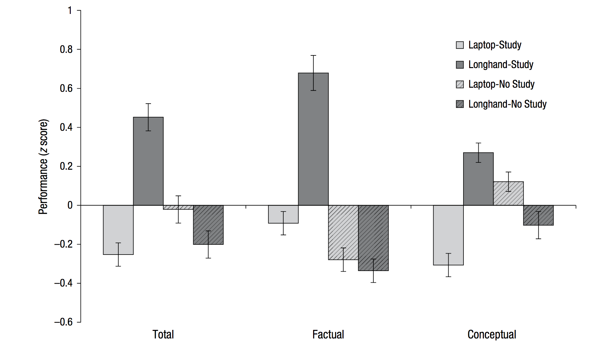
Laptop Use in the Classroom: Notetaking Mueller & Oppenheimer, 2014 (updated 2018)
Notes:
Participants who took longhand notes AND were able to study from them performed better than anyone else

Slide 13
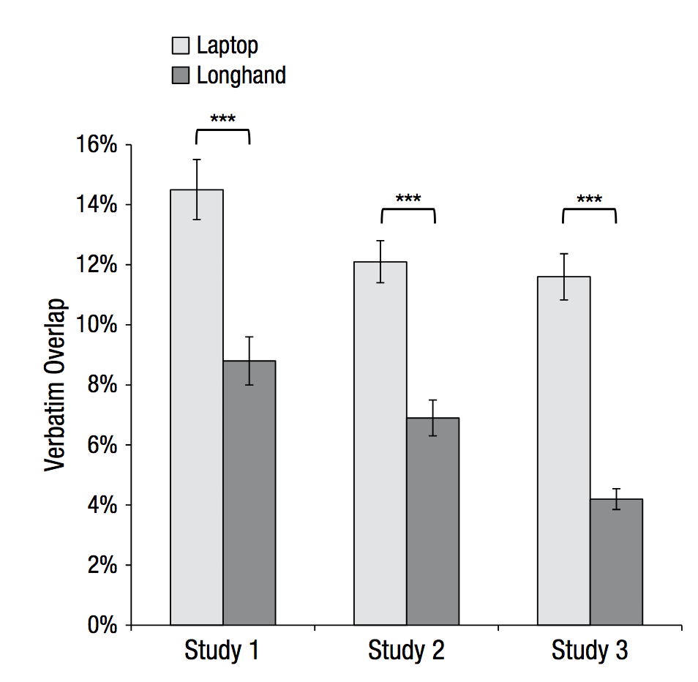
Laptop Use in the Classroom: Notetaking Mueller & Oppenheimer, 2014 (updated 2018)
Because we are able to type much quicker than we write, it is much easier to take verbatim (word for word) notes with a laptop.

Slide 14


ME (Instructor)
YOU (student)
Notes:
When typing, it can actually be difficult not to take verbatim notes (we end up mindlessly recording the lecture, just like a courtroom transcriber, without actually thinking about the material at all!)

Slide 15
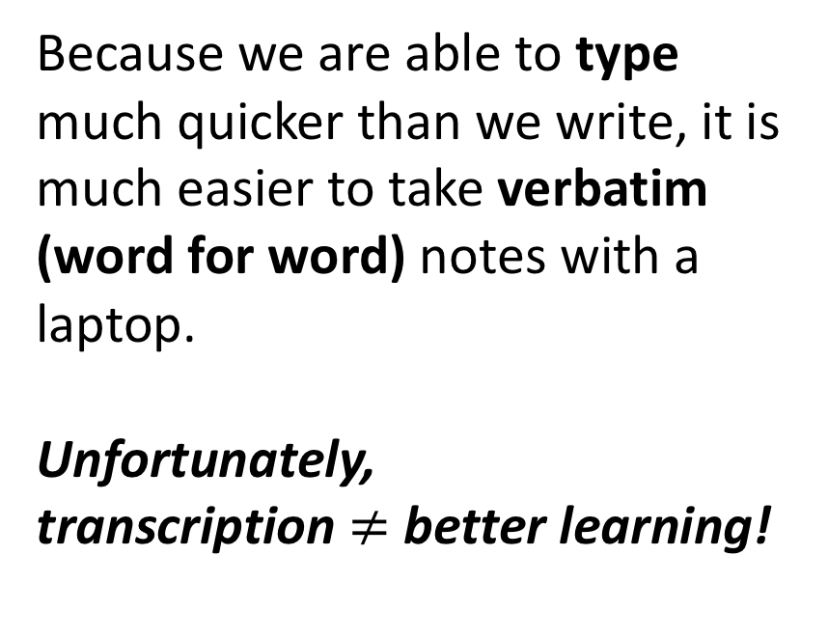
Laptop Use in the Classroom: Notetaking Mueller & Oppenheimer, 2014 (updated 2018)
Because we are able to type much quicker than we write, it is much easier to take verbatim (word for word) notes with a laptop.
Unfortunately,
transcription $≠$ better learning!

Slide 16
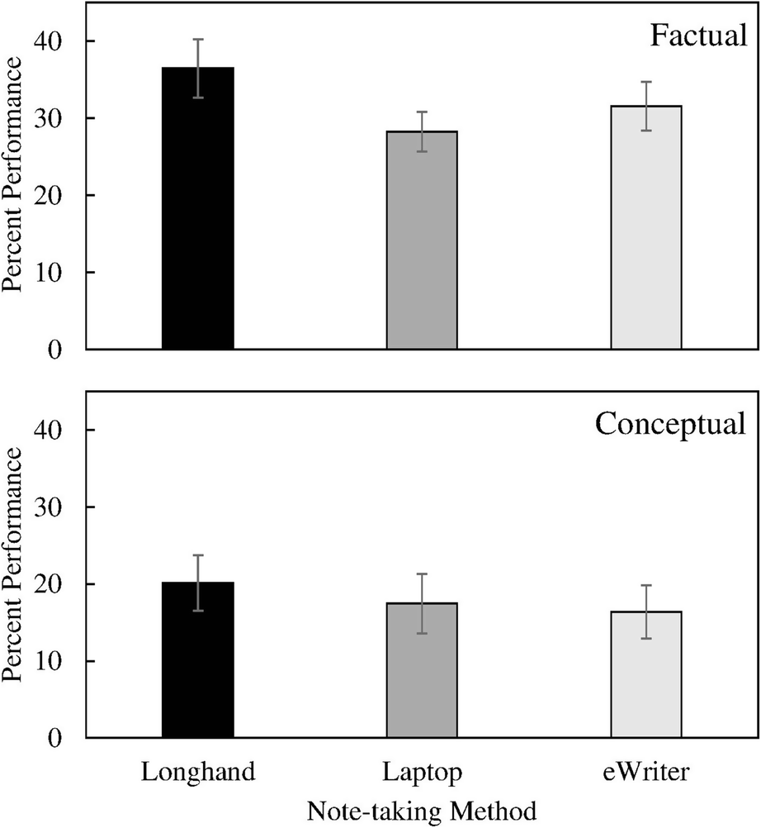
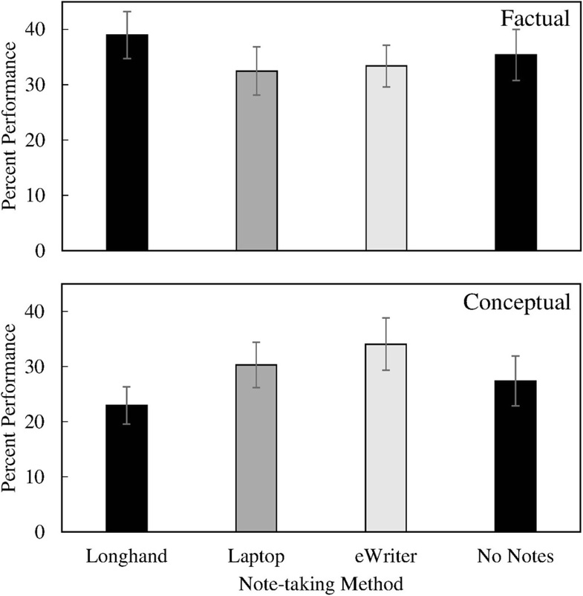
Replication & Extension: Morehead, Dunlosky, Rawson, 2019

Slide 17
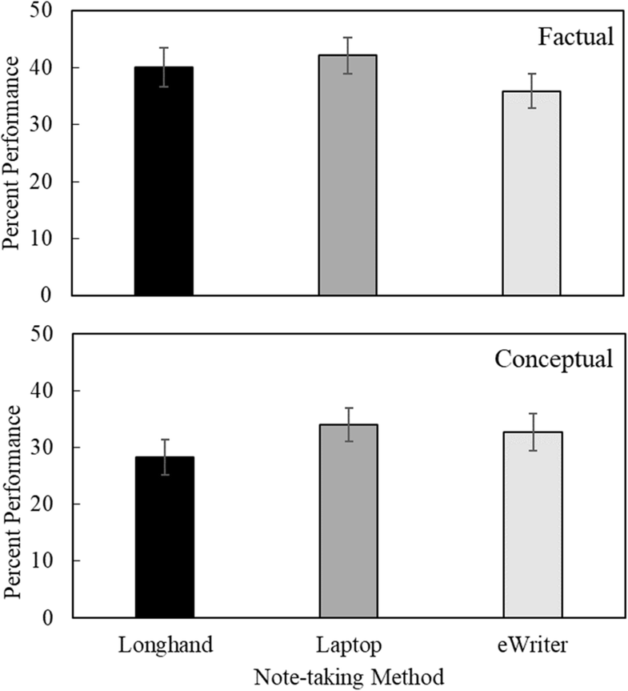
Delayed test; After studying from notes for 7 minutes
No differences between groups
Notes:
Conclusions:
- Small longhand-superiority effect may be larger in the classroom (multi-tasking)
- Content of notes (inclusion of relevant material) more important than note-taking method (longhand, laptop, eWriter)
- Moderating factors: e.g., images and symbols?

Slide 18
Laptop Use in the Classroom
What are the key take-aways of this research?
Potential solutions?
What are some practical rules/guidelines we should establish for laptop use in this classroom?
Notes:
E.g., if you take notes on your laptop during class, perhaps you can redo them in longhand form later that day – making sure to put things into your own words
E.g., if you might be tempted to multitask during class, sit at the back of the room where you’ll be less likely to distract your classmates

Slide 19

Laptops and tablets and cell phones – oh my!
Of course, laptops are not the only potential source of distraction
Multitasking on cell phones and tablets is (not surprisingly) also detrimental to learning!
And again, the research indicates that it’s not only the USER of the device whose learning is impaired – but everyone’s performance suffers when electronic devices are permitted in the classroom (e.g., Lee et al., 2017; Glass & Kang, 2018)
Notes:
Ask students: How many of you have looked at your phone since the lecture began? (In the last 10 minutes? 5 minutes? 1 minute? Right now? :)
NOTE: The following article is not elaborated on in the slides, but it is worth reading and potentially discussing with your students!
ARTICLE: Lee, S., et al (2017). The effects of cell phone use and emotion-regulation style on college students’ learning. Applied Cognitive Psychology, 31, 360-366. AVAILABLE: https://doi.org/10.1002/acp.3323
ABSTRACT: Cell phones are becoming an inevitable part of the classroom, but extant research suggests that using cell phones in the classroom impairs academic performance. The present study examined the impact of different cell phone policies on learning and emotion‐regulation style. Participants were randomly assigned to one of four experimental conditions: cell phone usage allowed, cell phone possession allowed but without usage, cell phones removed, and a no‐instruction control group. All participants watched a 20‐minute lecture and were sent text messages to mimic classroom distractions. Afterward, participants took a multiple‐choice test and filled out questionnaires assessing their level of obsessiveness, nomophobia, and mindfulness. Participants who had their cell phone taken away performed best on the test with no other differences. None of the emotional‐regulation measures moderated the results. These findings provide important insight as to how cell phone policies can optimize learning in the classroom.

Slide 20

Glass & Kang, 2018
Classroom experiment, using two identical back-to-back sections of an upper-year cognitive psychology course which met twice a week
In one section, electronic devices were banned on Tuesdays
In the other section, electronic devices were banned on Thursdays
Examined student performance on same-day in-class questions, unit exam (test) questions, and final exam questions
Notes:
ARTICLE: Glass, A. L., & Kang, M. (2018) Dividing attention in the classroom reduces exam performance, Educational Psychology, DOI: 10.1080/01443410.2018.1489046
AVAILABLE: https://doi.org/10.1080/01443410.2018.1489046
ABSTRACT: The intrusion of internet-enabled electronic devices (laptop, tablet, and cell phone) has transformed the modern college lecture into a divided attention task. This study measured the effect of using an electronic device for a non-academic purpose during class on subsequent exam performance. In a two-section college course, electronic devices were permitted in half the lectures, so the effect of the devices was assessed in a within-student, within-item counterbalanced experimental design. Dividing attention between an electronic device and the classroom lecture did not reduce comprehension of the lecture, as measured by within-class quiz questions. Instead, divided attention reduced long-term retention of the classroom lecture, which impaired subsequent unit exam and final exam performance. Students self-reported whether they had used an electronic device in each class. Exam performance was significantly worse than the no-device control condition both for students who did and did not use electronic devices during that class.

Slide 21
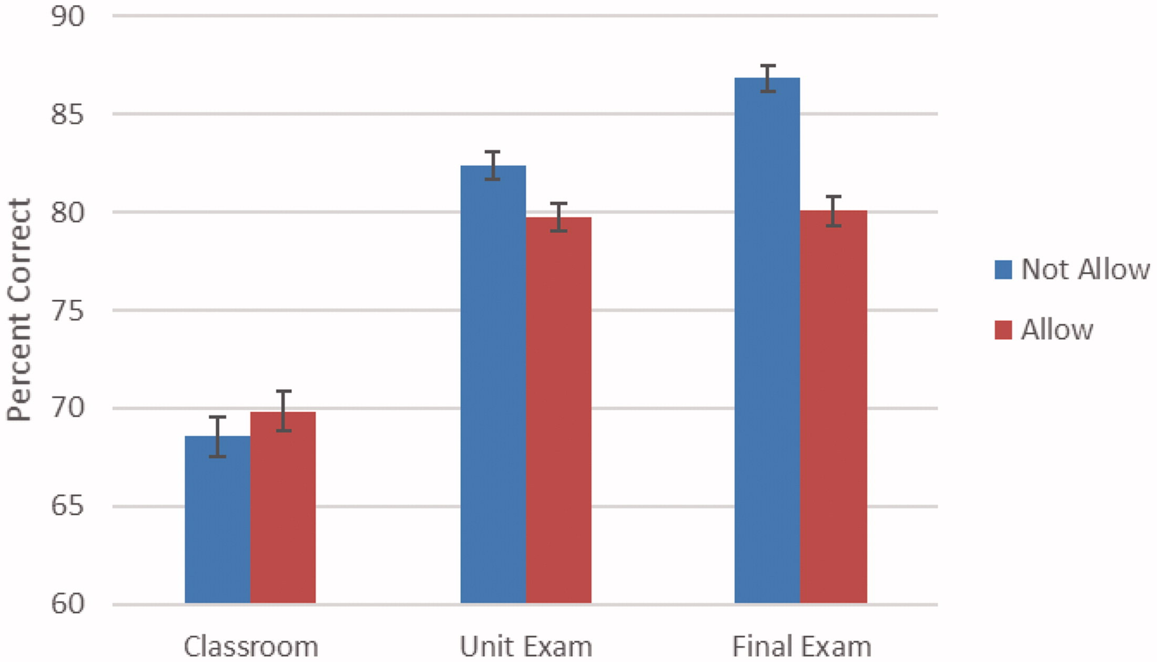
Glass & Kang, 2018: Results
Notes:
Ask students to explain the figure/results
Key finding: use of the electronic devices impaired long-term retention (i.e., real learning)

Slide 22
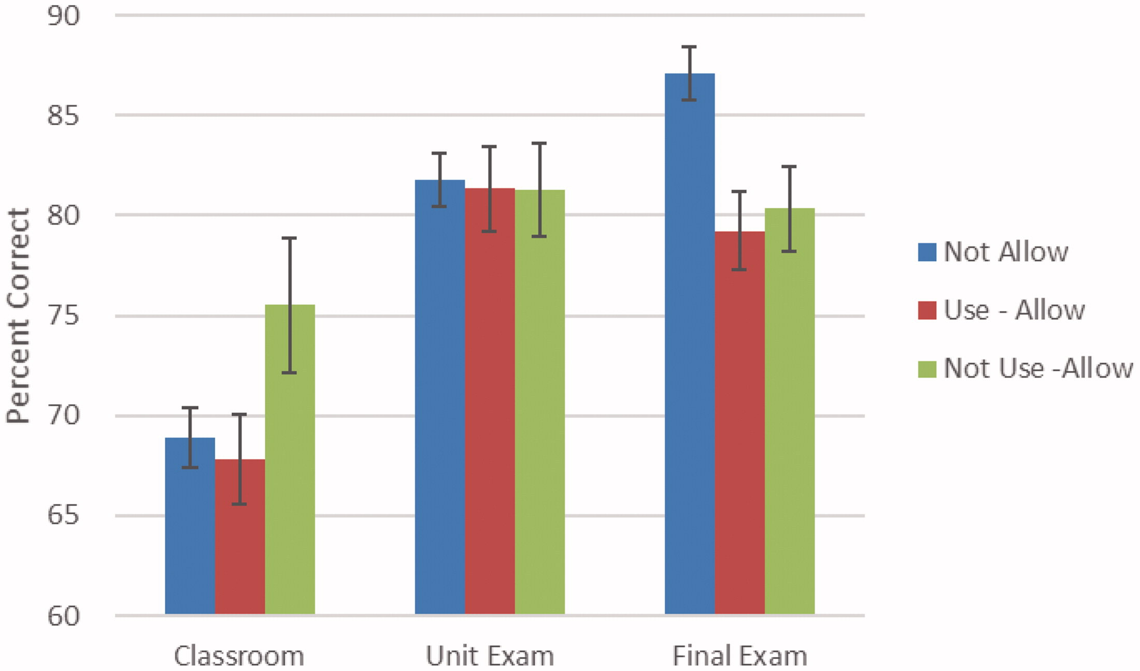
Glass & Kang, 2018: Results
Notes:
Subsequent analyses looked at student reports of whether they actually used their devices on days when they were allowed (versus did not use)
Again, key result is for the final exam → best performance when NO ONE is using their electronics. When they were allowed, a majority of students chose to use their devices, bringing down their own performance, as well as the performance of the few students who chose NOT to use their devices.

Slide 23
Glass & Kang, 2018: Final Thoughts
Just because you can answer a question correctly in class, does not mean that your cellphone or laptop use is not impairing your learning!
"This is one of the occasional cases in human cognition where our intuitions mislead us, because even though they can divide their attention well enough to remember in the moment … what happens is that a week later, they’ve pretty much forgotten what happened in class," Glass said. "What’s the point of going to class in the first place if a week later you don’t remember it?” (Inside Higher Ed, July 27 2018)
Notes:
Link to Inside High Ed Article: https://www.insidehighered.com/news/2018/07/27/class-cellphone-and-laptop-use-lowers-exam-scores-new-study-shows

Slide 24
Glass & Kang, 2018: Final Thoughts
The devices are not the enemy – after all, even on the “not allowed” days, these devices were used to answer the in-class questions!
It is the misuse of these devices and subsequent distraction that is problematic, along with the fact that it can be very difficult for us to recognize the negative effects that the devices are having on us
If we don’t recognize something as being a problem, it is very difficult to be motivated to find a solution!

Slide 25
Classroom Guidelines for Electronics Use
Notes:
As a class, you may wish to brainstorm some ideas/guidelines for cellphone/device use in class. E.g., allow students the option of dropping off their smartphone at the front of the class as they come in. Or set up a norm where everyone turns off their phone at the beginning at class and keeps in hidden away. Whatever solutions you and your students come up with!

Slide 26

Electronic Devices Outside of the Classroom
Of course, the classroom is not the only place where learning occurs!
Electronic devices can impair learning outside of the classroom as well
Notes:
Can ask students to share some of their solutions for how they reduce distractions while studying.

Slide 27

Electronic Devices Outside of the Classroom
Research has shown that individuals who report having a strong dependence on their cellphones perform significantly better on cognitive tasks when their cellphone was out of sight (Ward et al., 2017)
Even if the phone was turned off, its mere presence impaired performance
Again, people appear to be largely unaware of this – participants do not report consciously thinking about or being distracted by their phones!
Notes:
NOTE: The 13-items used to measure cellphone attachment/dependence are included in the Appendix available here: https://www.journals.uchicago.edu/doi/suppl/10.1086/691462/suppl_file/2016022Appendix.pdf
(You could have students complete the measure – other similar measures also exist, such as The Nomophobia Questionnaire NMP-Q; Yildirim & Correia, 2015)
ARTICLE: Ward, A. F., Duke, K., Gneezy, A., & Bos, M. W. (2017). Brain drain: The mere presence of one’s own smartphone reduces available cognitive capacity. Journal of the Association for Consumer Research, 2, 140-154.
AVAILABLE: https://www.journals.uchicago.edu/doi/10.1086/691462
ABSTRACT: Our smartphones enable—and encourage—constant connection to information, entertainment, and each other. They put the world at our fingertips, and rarely leave our sides. Although these devices have immense potential to improve welfare, their persistent presence may come at a cognitive cost. In this research, we test the “brain drain” hypothesis that the mere presence of one’s own smartphone may occupy limited-capacity cognitive resources, thereby leaving fewer resources available for other tasks and undercutting cognitive performance. Results from two experiments indicate that even when people are successful at maintaining sustained attention—as when avoiding the temptation to check their phones—the mere presence of these devices reduces available cognitive capacity. Moreover, these cognitive costs are highest for those highest in smartphone dependence. We conclude by discussing the practical implications of this smartphone-induced brain drain for consumer decision-making and consumer welfare.

Slide 28
Products/apps you may wish to look into if you find yourself unable to control technological distractions (all have free options)
https://getcoldturkey.com/
Can block yourself out of certain websites, the entire Internet, apps, etc., during specific time windows (e.g., when you have a class!)
http://selfcontrolapp.com/ (for Mac users)
StayFocusd (Google Chrome extension)
Limits time spent on distracting websites
Freedom (available in the app store) – same idea, works on your iPhone, iPad
https://www.boomeranggmail.com/
If you use Gmail and email is a major distraction during class/studying
Notes:
Note: Most of these (except for boomerang, which I use) were found via an Internet search – I have not used them and this is certainly not meant as an endorsement. I just chose ones that were free and seemed relatively popular or well-reviewed! You and/or your students may know of better (or certainly additional) options!

